Slide 1
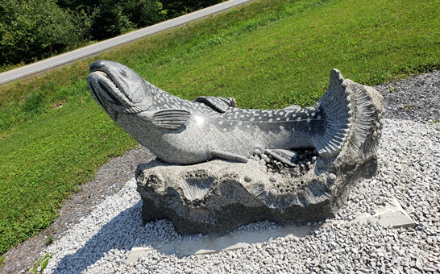
Hatchery Modernization Information

Slide 2
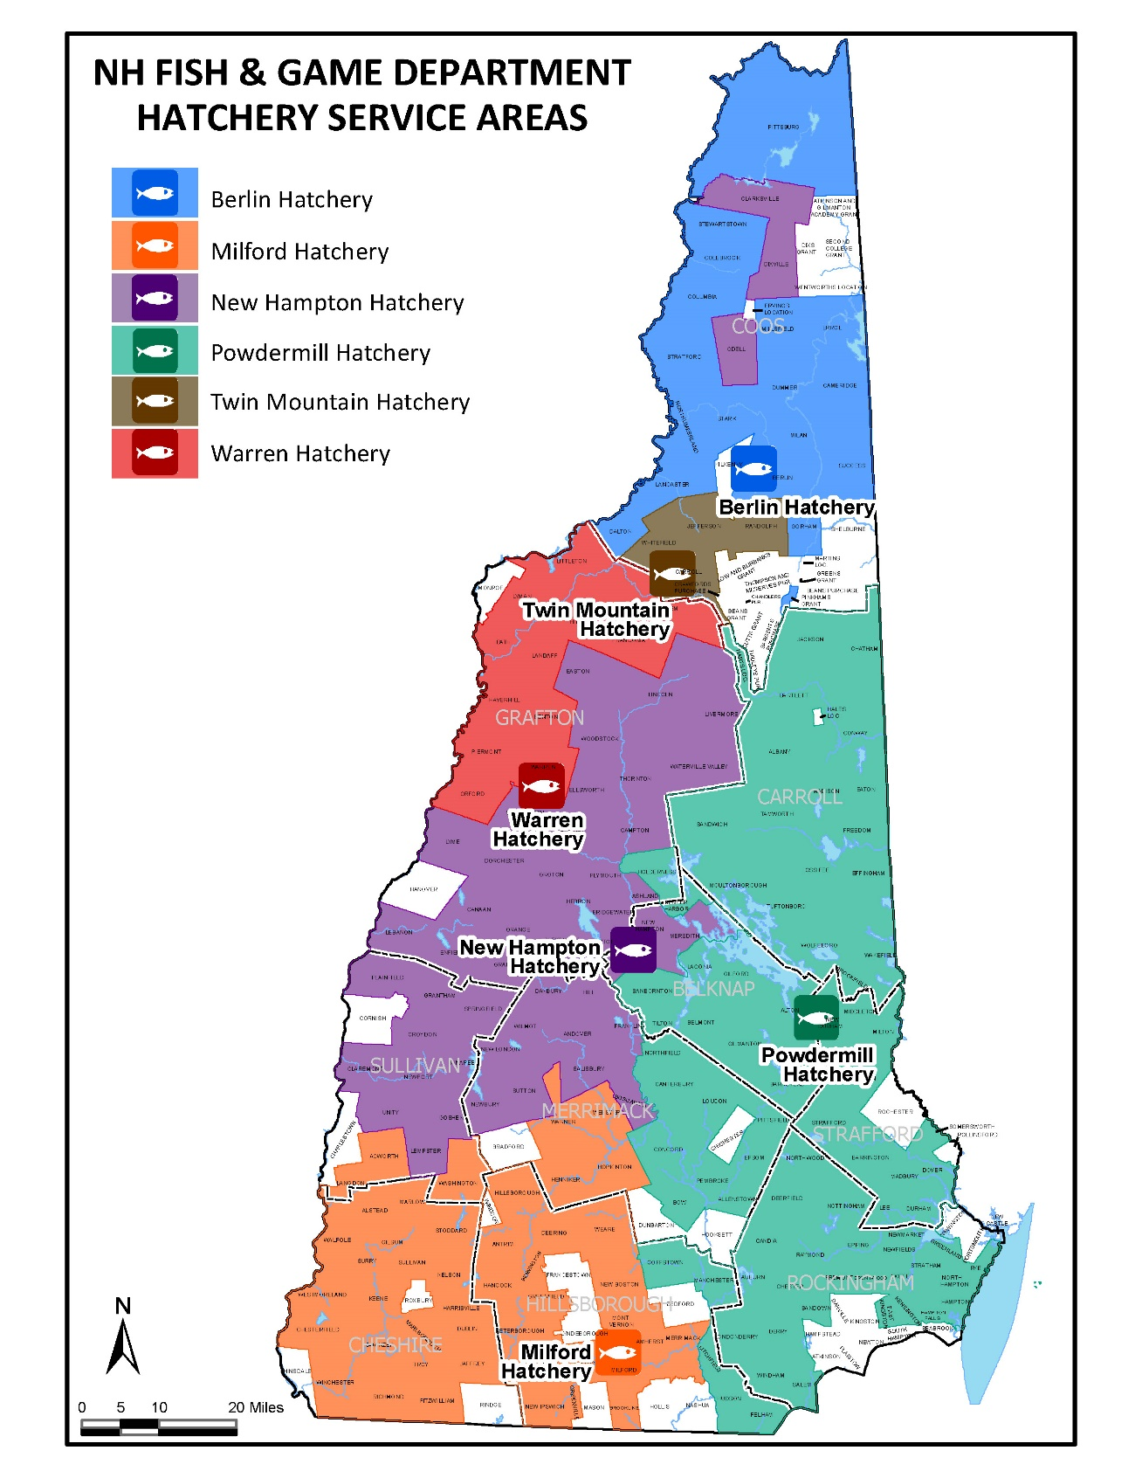
Stocking Areas by Hatchery

Slide 3
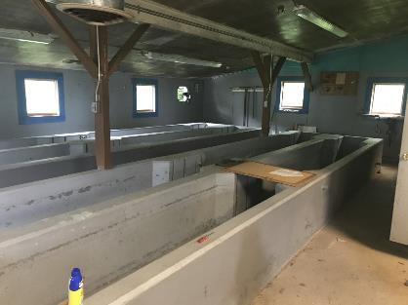
Annual Production Fish
Species/Age | Total Number | Fish/lb
EBT I | 30000 | 3.5
EBT 2 | 1400 | 1.0
RT I | 25000 | 2.5
BT I | 16000 | 2.5

Slide 4
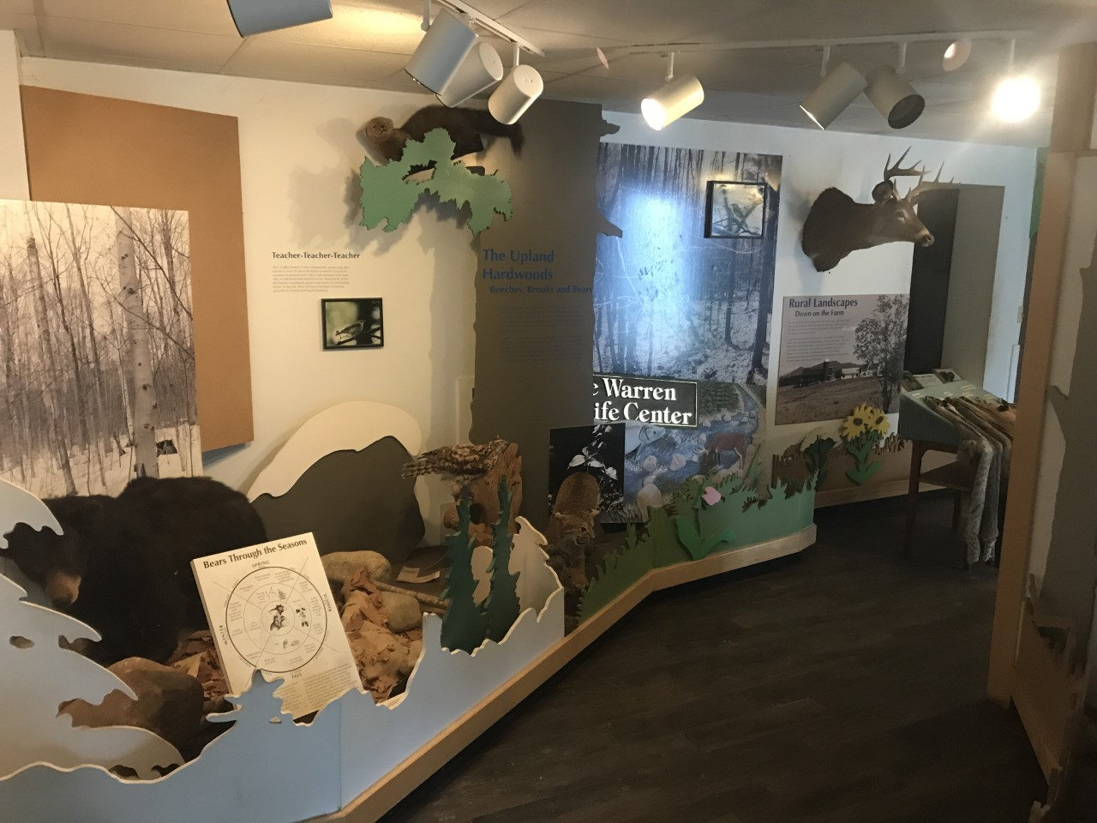
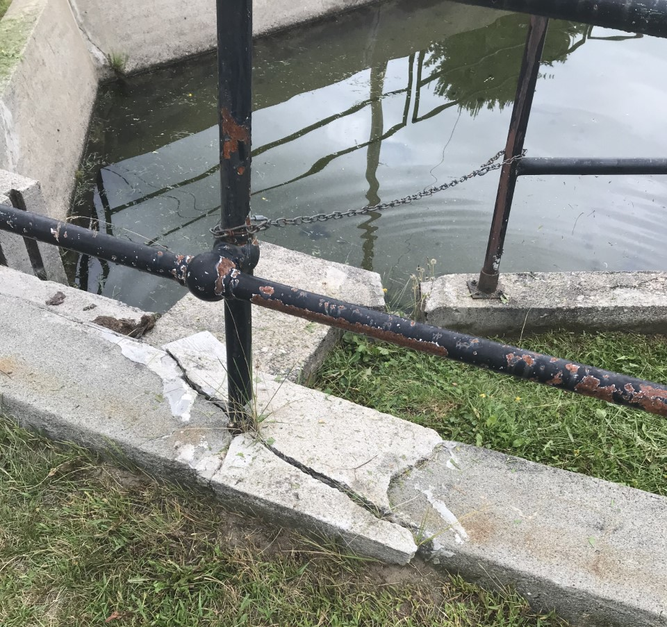
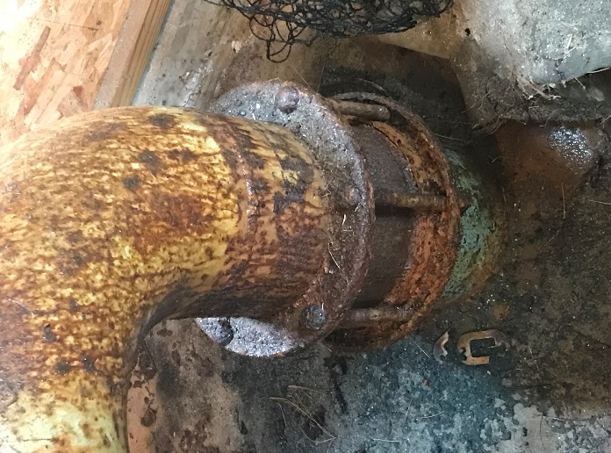
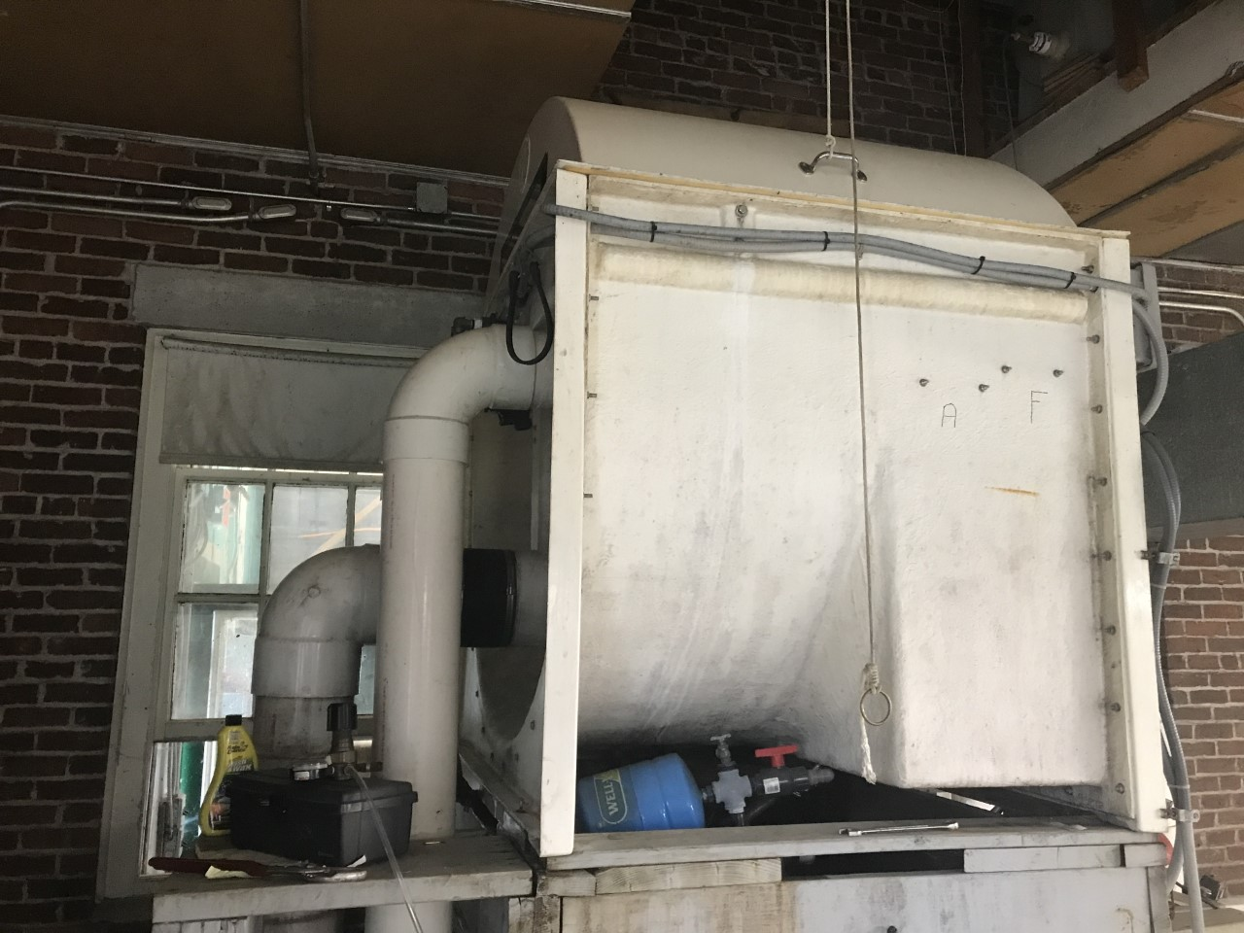
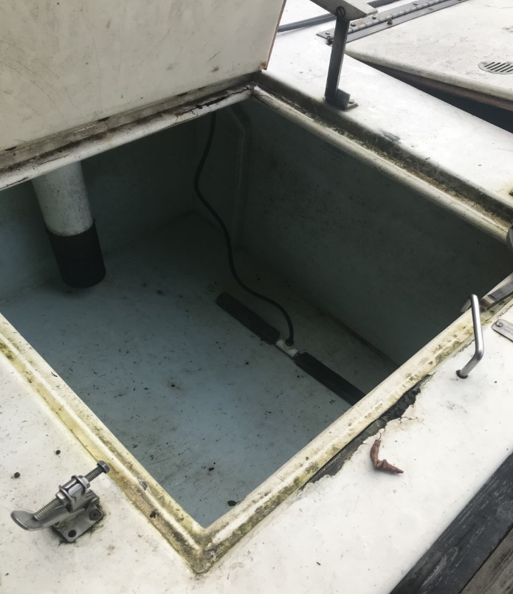
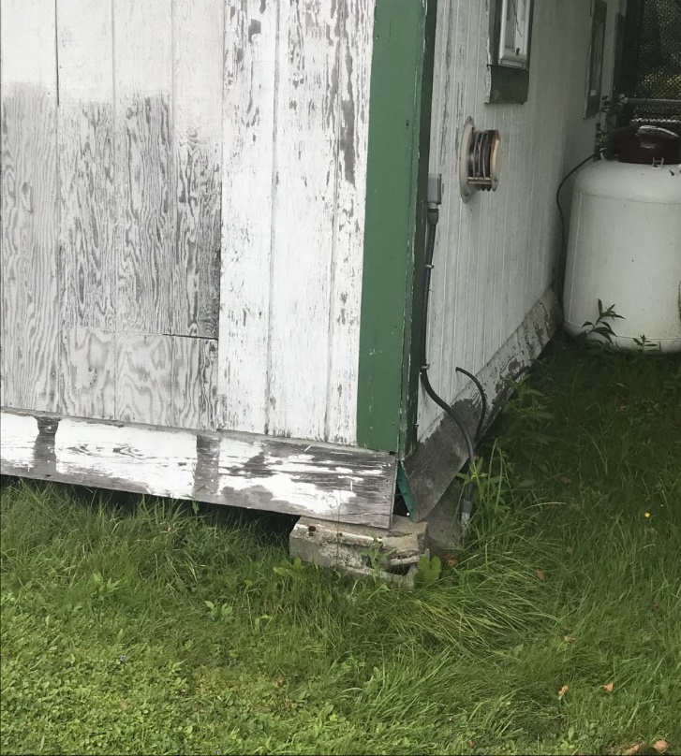
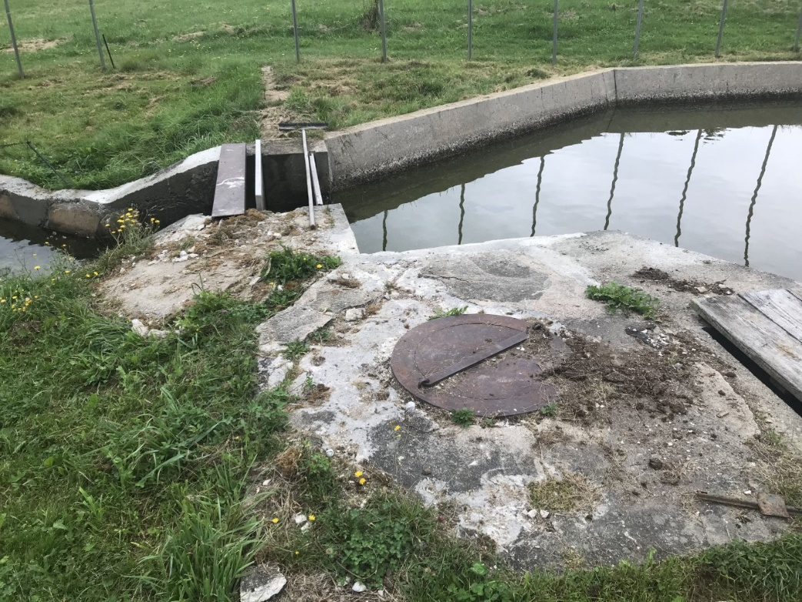
Lead based paint
Warren Fish Hatchery
Outdated Visitor’s Center
Broken drum filter

Slide 5
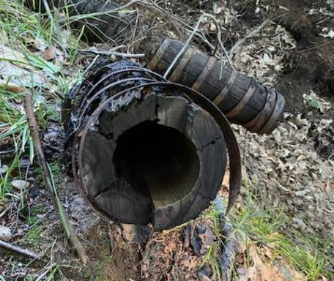
Annual Production Fish
Species/Age | Total Number | Fish/lb
EBT I | 91000 | 2.75
EBT 2 | 2400 | 0.77
RT I | 40000 | 1.5
BT I | 25000 | 2.75
LLS I | 26000 | 8
LLS (eggs) | 60,000
Wooden spring intake pipe

Slide 6
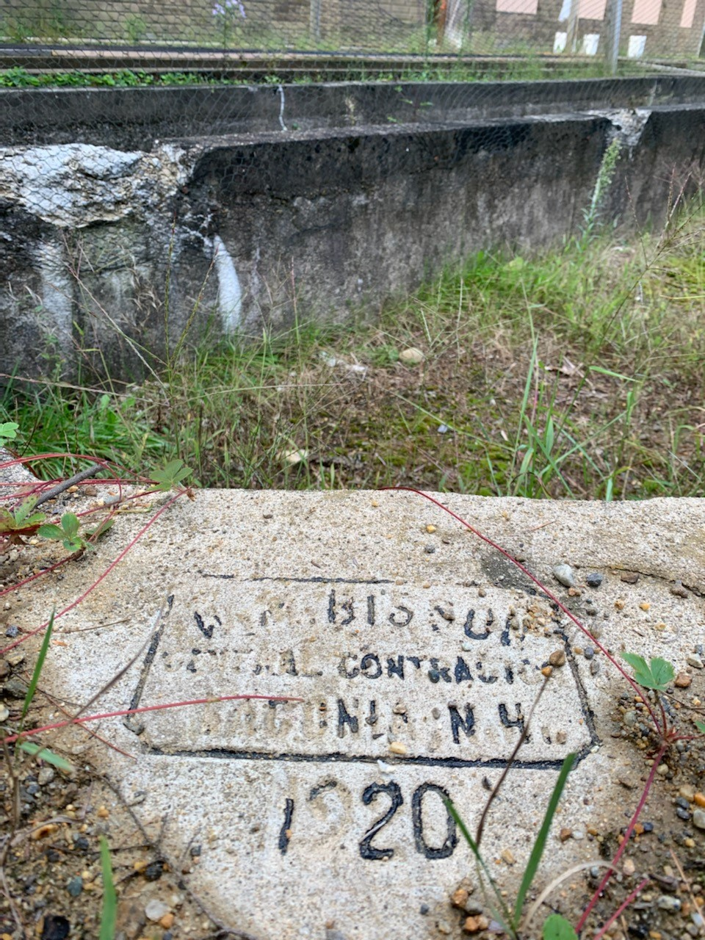
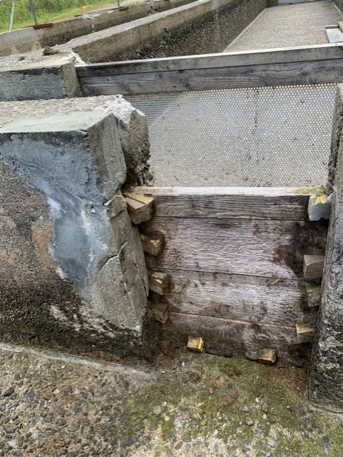
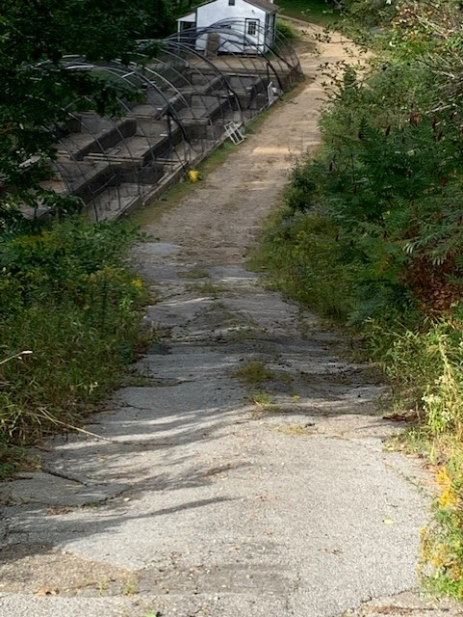
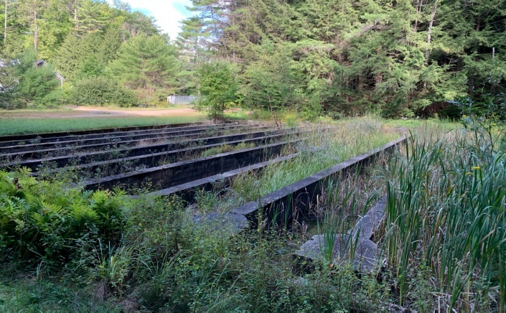
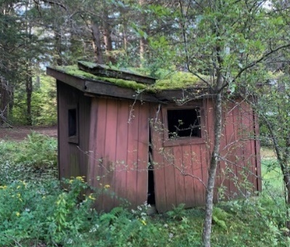
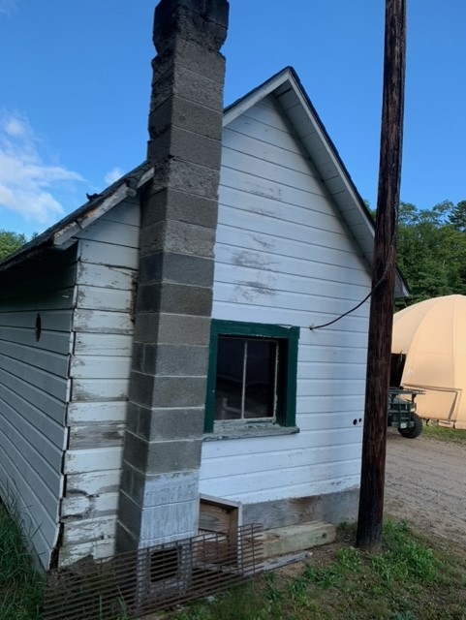
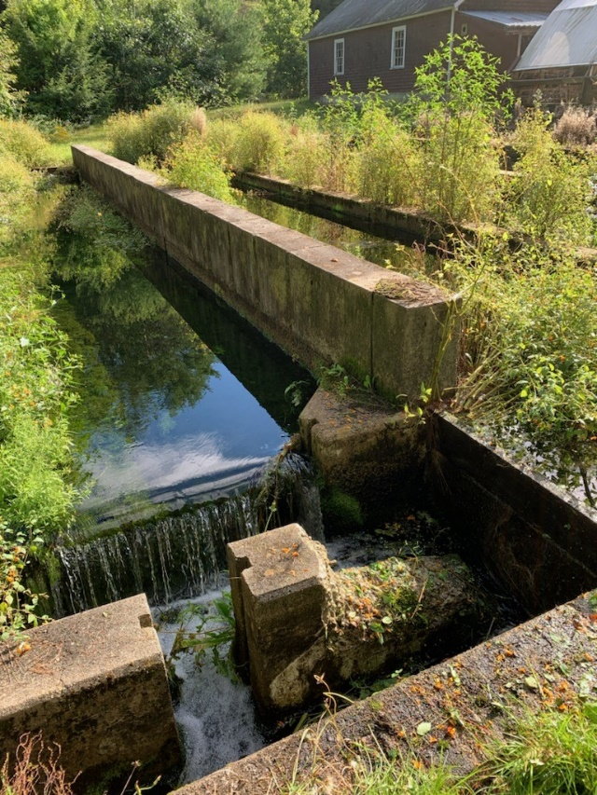
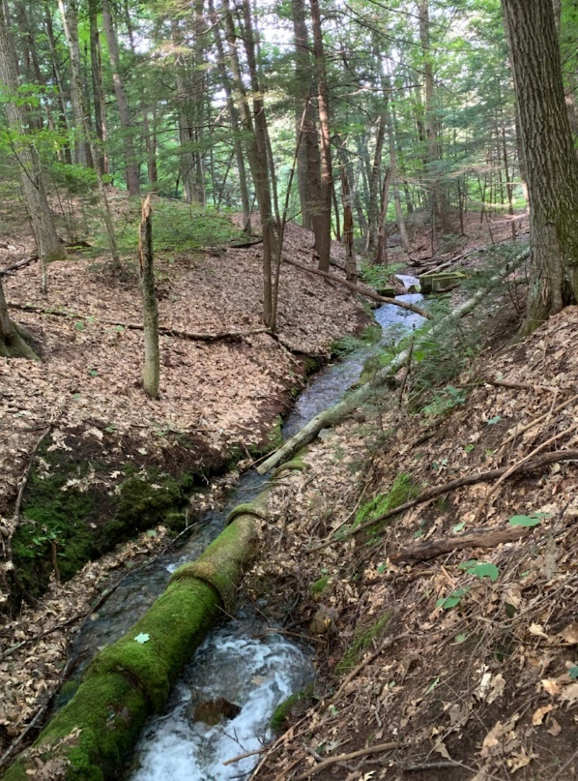
New Hampton Hatchery
Intake pipe

Slide 7
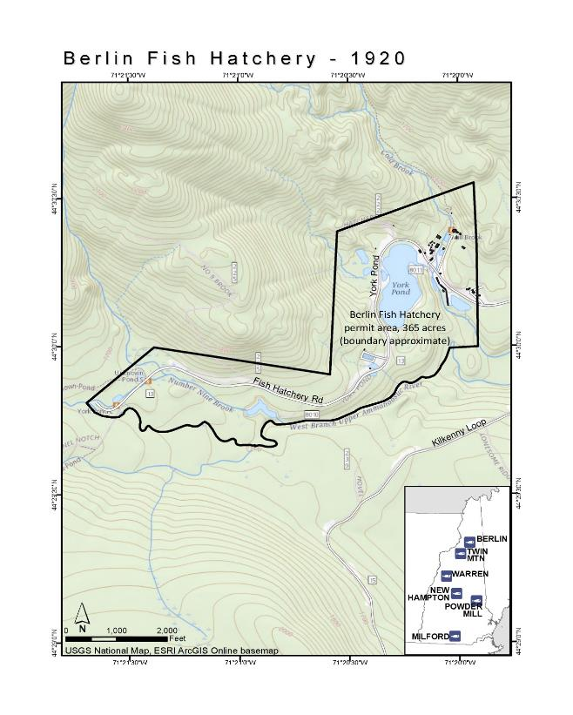
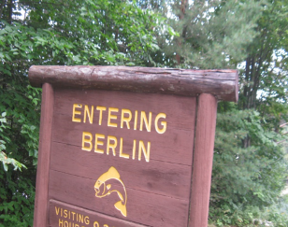
Annual Production Fish
Spp Age | Total Number | Fish per Lb
BT 1 | 43000 | 2.29
EBT egg | 150000 | 324.3
EBT fingerling | 125000 | 33.41
EBT1 | 40000 | 3.46
EBT1 | 50000 | 5.55
EBT2 | 7000 | 1.21
RT fingerling | 150000 | 9.19
RT 1 | 78000 | 3.04
Show Pond &Brood

Slide 8
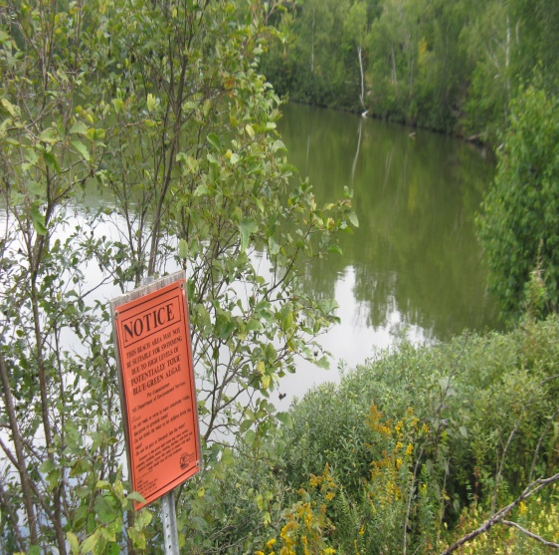
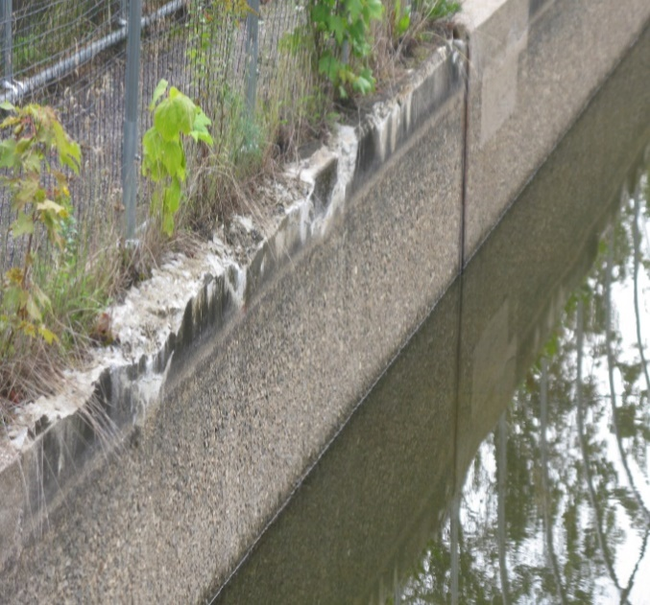
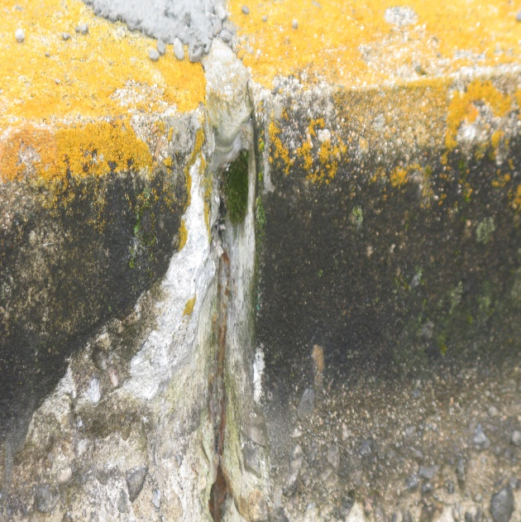
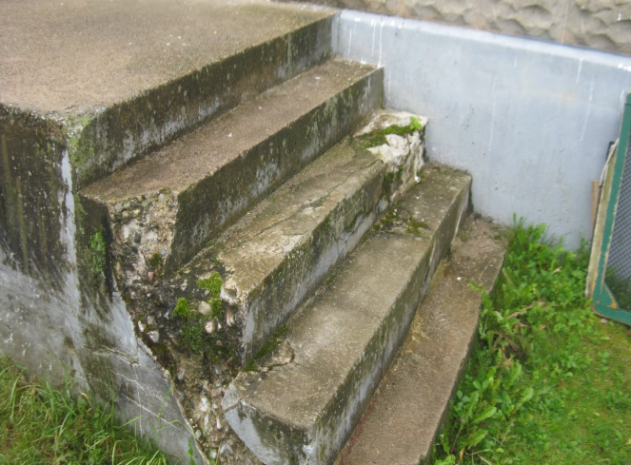
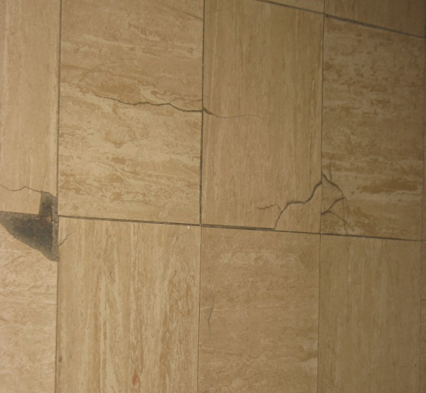
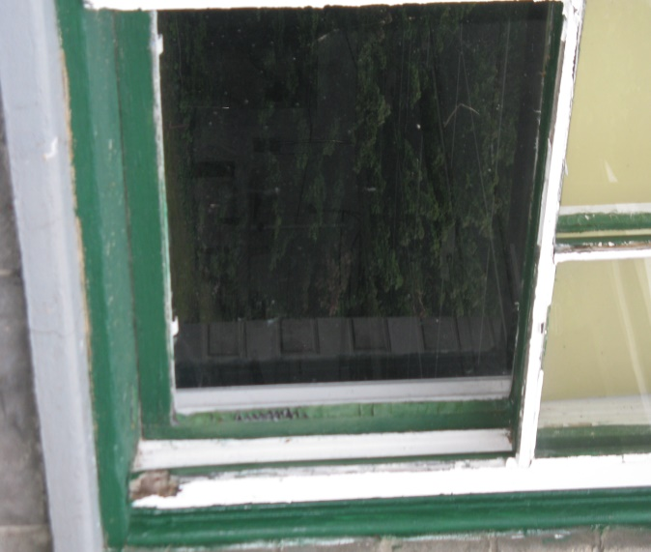
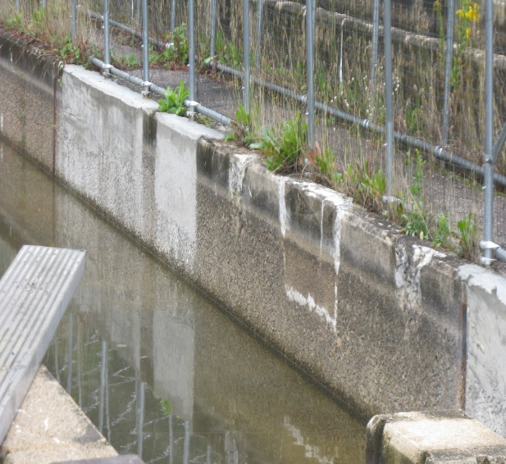
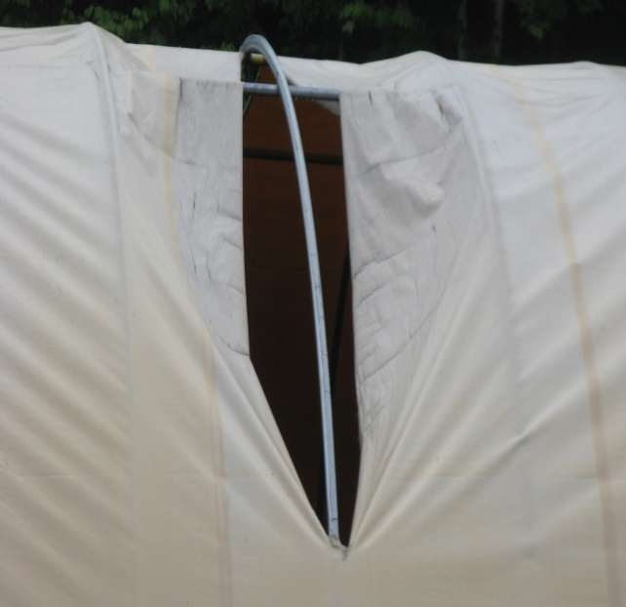
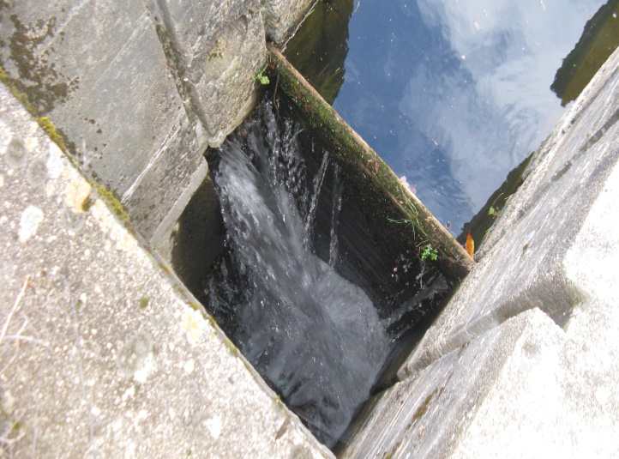
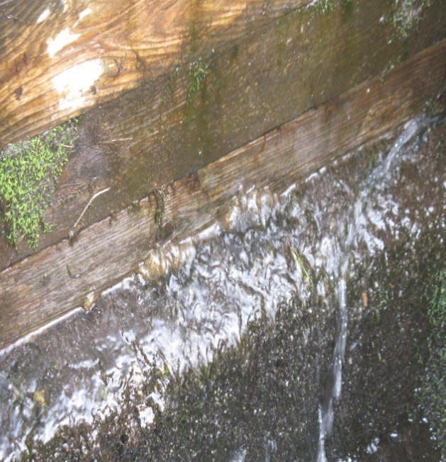
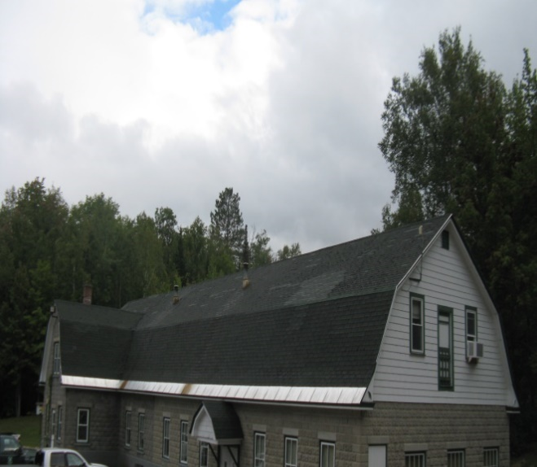
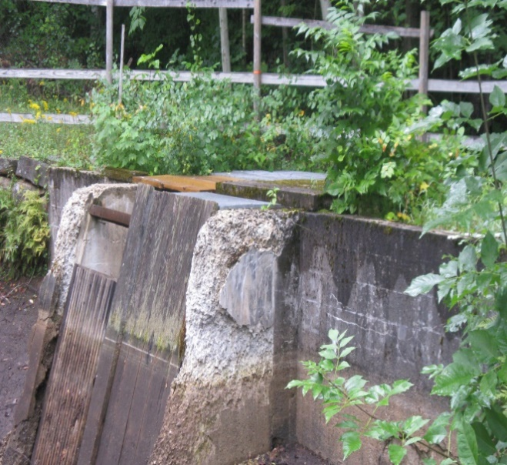
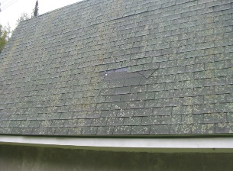
Berlin Fish Hatchery
cracked flooring

Slide 9
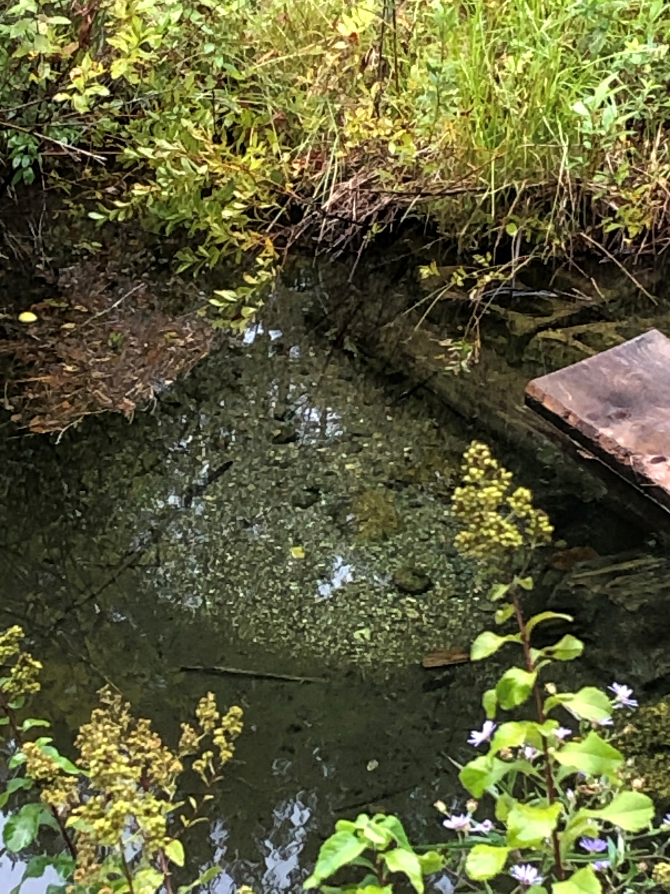
Annual Production Fish
Spp Age | Total Number | Fish per Lb
RT -0 | 150,000 | 107
RT-1 | 25,000 | 1.4
EBT -1 | 24,000 | 2.4
EBT -2 | 2,000 | 0.78

Slide 10
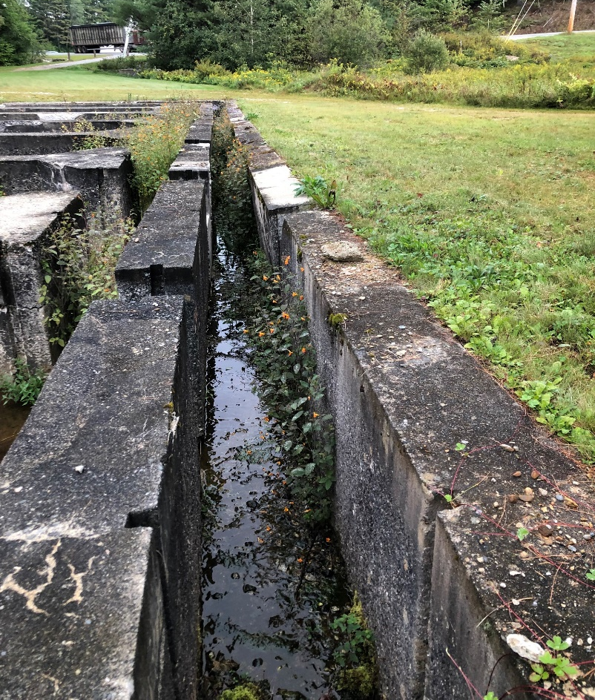
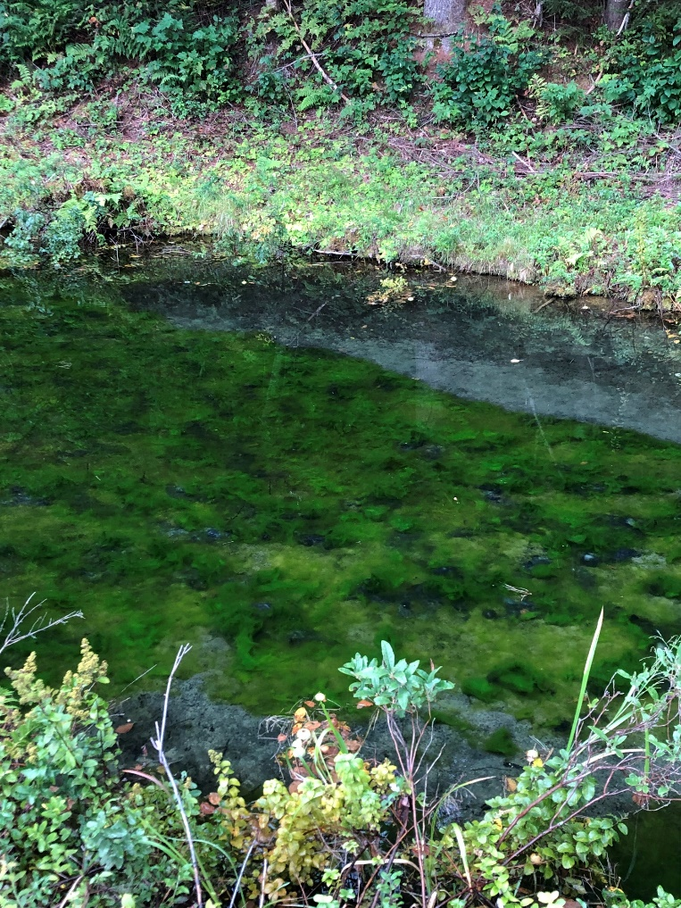
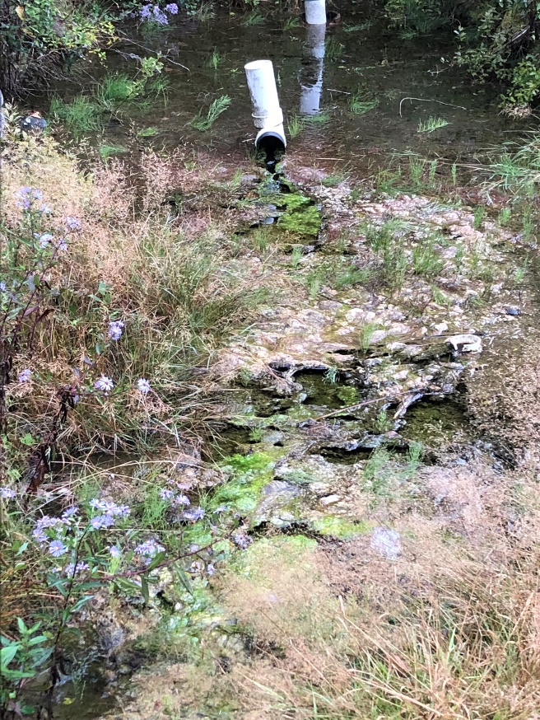
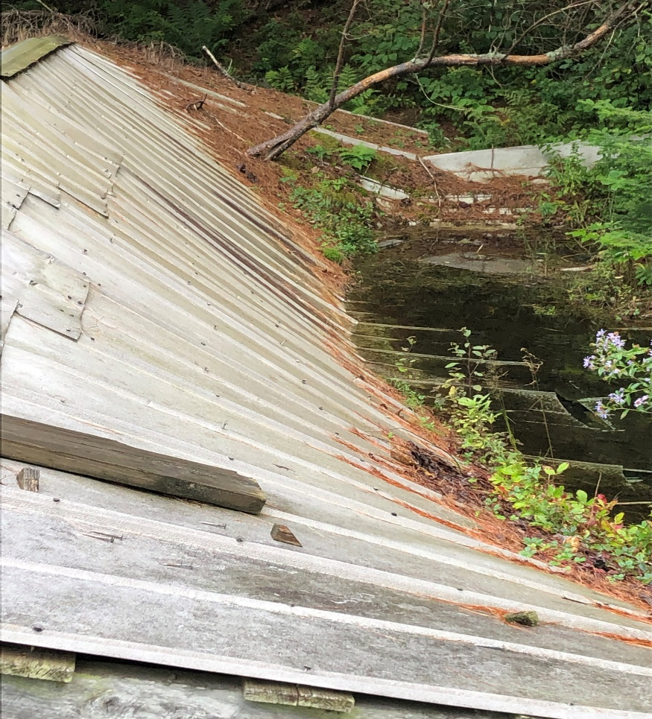
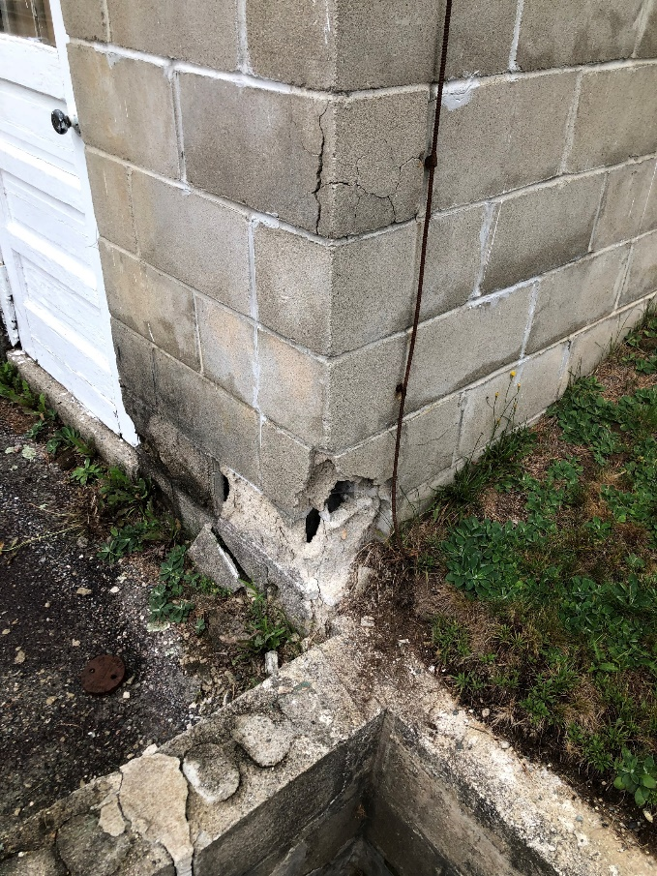
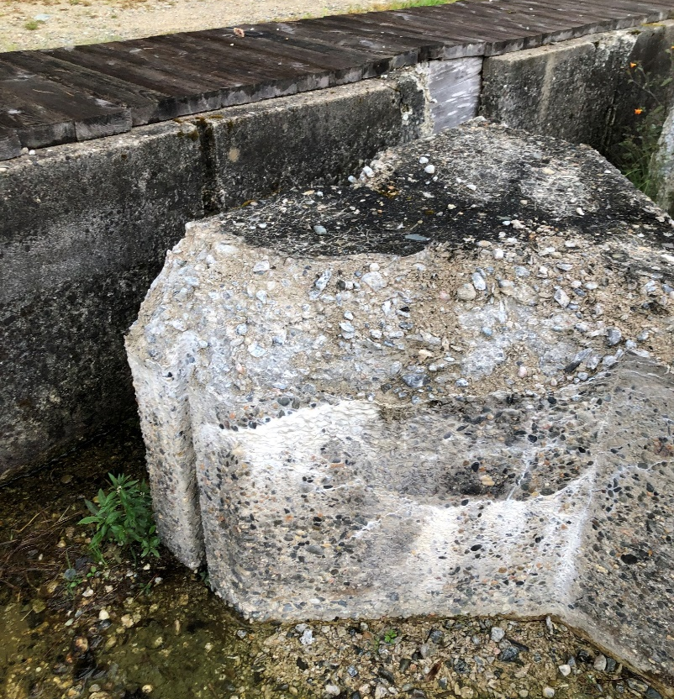
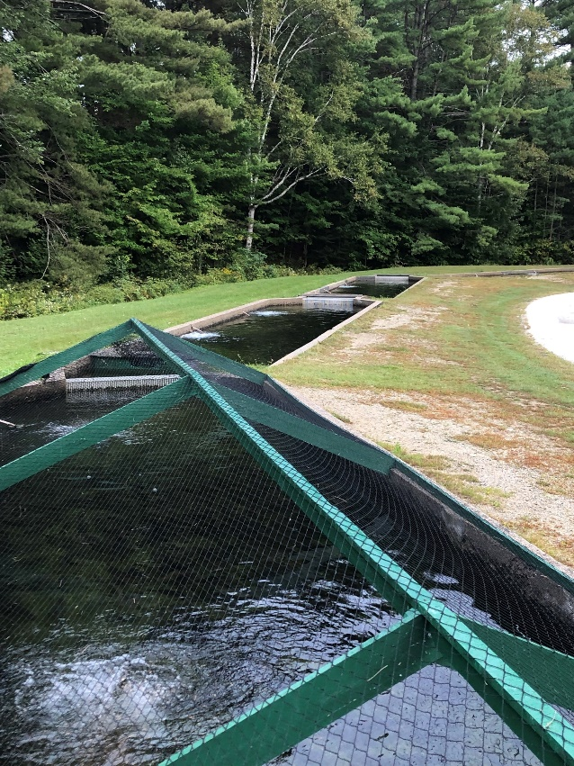
Intake springs filled with algae and material, clogs pipes and reduces water flow, causing fish mortality
Vegetation and trees growing on rooftops
Raceways no longer in service due to cracked and collapsed sidewalls; vegetation growing in failed areas
Ineffective predation control
Twin Mountain Hatchery

Slide 11
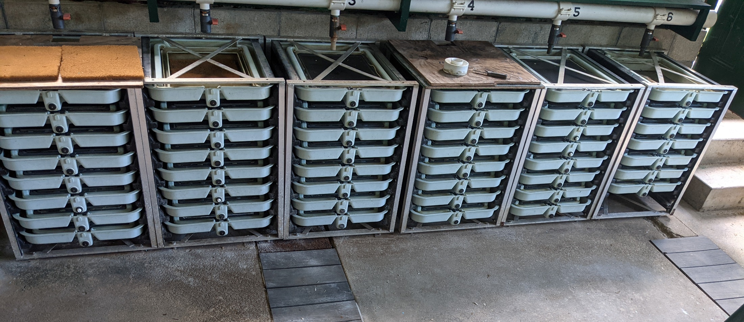
Annual Production Fish
Spp Age | Total Number | Fish per Lb
EBT 1 | 155,000 | 3.87
EBT 2 | 5,200 | 0.92
RT 1 | 90,000 | 2.26
BT 1 | 37,000 | 3.02
BT 2 | 2,500 | 1.2

Slide 12
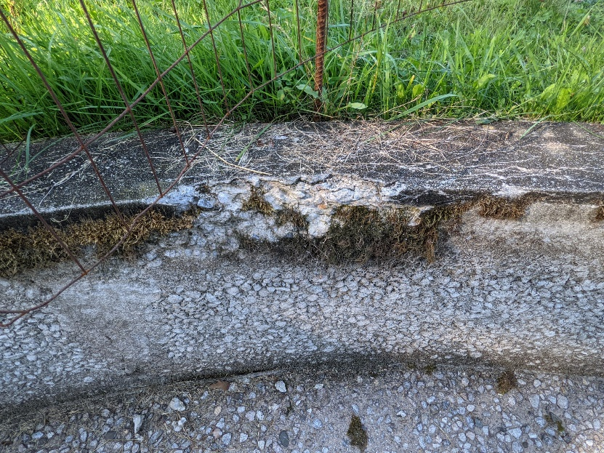
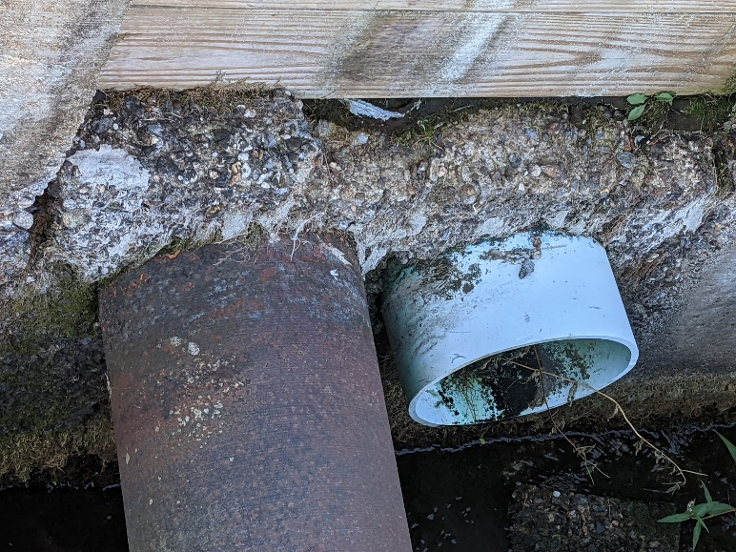
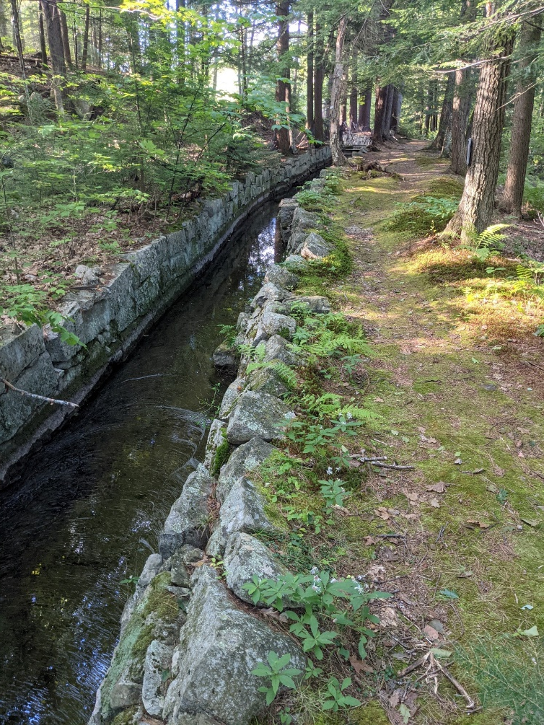
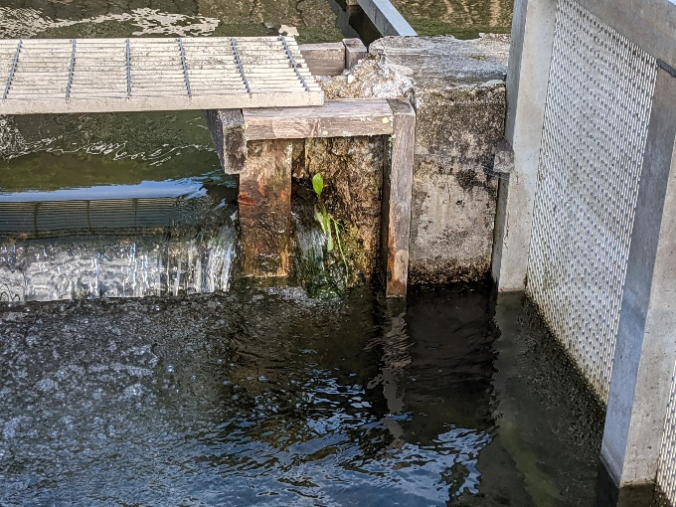
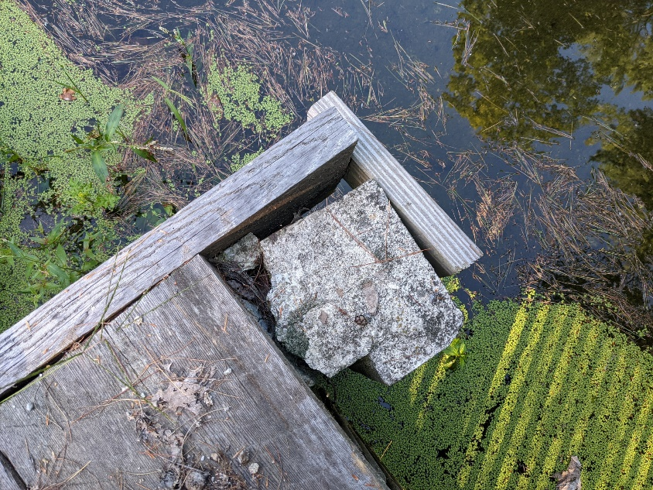
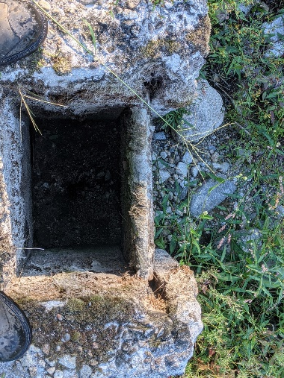
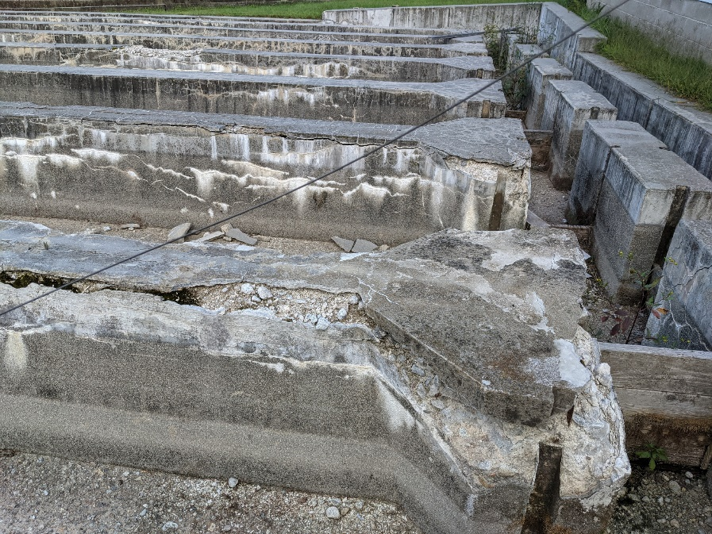
Powder Mill Hatchery
Clogged, failing pipes
Failing intake pipe conditions

Slide 13
Annual Production Fish
Spp Age | Total Number | Fish per Lb
BT 1 | 32700 | 2.1
EBT 1 | 71800 | 2.8
RT 1 | 53700 | 1.4

Slide 14
Milford Fish Hatchery

Slide 15
Better Water Quality through Improvements

Slide 16
New Hatchery Draft Model
Treatment swale

Slide 17
Roxbury VT

